Slide 1
INTRODUCTION TO MRI
Lynne J. Williams, Ph.D.
BCCH MRI Research Facility
May 14, 2018
Structural & Functional MRI I

Slide 2


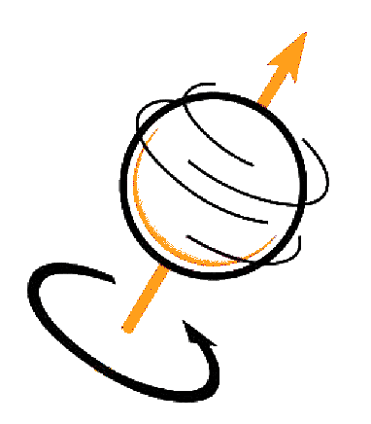
REVIEW
PROTONS PRECESS
PROTON RELEASE ENERGY
DATA GETS STORED
IN K-SPACE
Spin (aka angular momentum) generates a magnetic moment that allows protons to precess at a specific resonance (Larmor) frequency in an external magnetic field (B₀)
Radio frequency (B₁) waves knock over the aligned, precessing protons. When the protons realign with B₀, they release energy at the resonance (Larmor) frequency
The relaxation rates (return to alignment with B₀) are recorded in K-space as a spatial frequencies (number of cycles per meter)

Slide 3
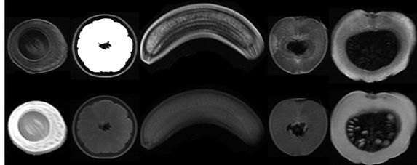
REVIEW
@lukenxie

Slide 4
REVIEW
T2
T1
@lukenxie

Slide 5
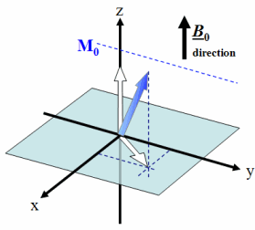
REVIEW

Slide 6
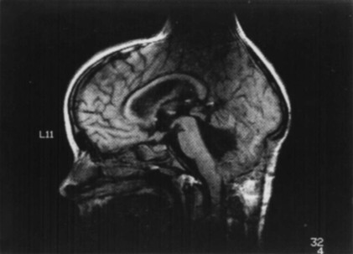
REVIEW
QUALITY
CONTROL

Slide 7
REVIEW
QUESTIONS?

Slide 8
WEEK 2
FUNCTIONAL MRI I
TODAY’S CLASS
Back to Quality Control
What is fMRI?
Physiological basis of fMRI
The BOLD signal
Scanning parameters that can affect measured BOLD response

Slide 9
WEEK 2
STRUCTURAL MRI
STRUCTURAL MRI
BACK TO
QUALITY CONTROL
Lynne J. Williams, Ph.D.
BCCH MRI Research Facility

Slide 10
RULE #4:
LOOK AT YOUR
DATA

QUALITATIVE AND QUANTITATIVE MEASURES NEEDED

Slide 11
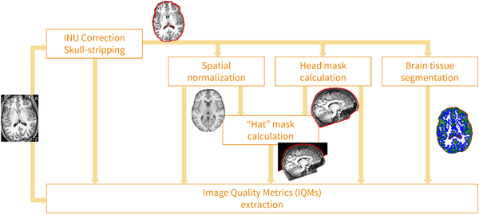

MRIQC’S PROCESSING DATA FLOW
Esteban O, Birman D, Schaer M, Koyejo OO, Poldrack RA, et al. (2017) MRIQC: Advancing the automatic prediction of image quality in MRI from unseen sites. PLOS ONE 12(9): e0184661. https://doi.org/10.1371/journal.pone.0184661
http://journals.plos.org/plosone/article?id=10.1371/journal.pone.0184661

Slide 12
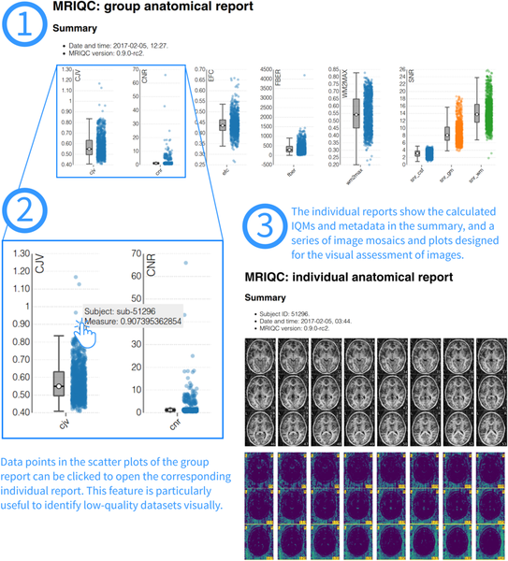
VISUAL REPORTS
Esteban O, Birman D, Schaer M, Koyejo OO, Poldrack RA, et al. (2017) MRIQC: Advancing the automatic prediction of image quality in MRI from unseen sites. PLOS ONE 12(9): e0184661. https://doi.org/10.1371/journal.pone.0184661
http://journals.plos.org/plosone/article?id=10.1371/journal.pone.0184661

Slide 13
Notes:
Signal-to-Noise Ratio (SNR) [snr]: The mean intensity within gray matter divided by the standard deviation of the values outside the brain. Higher values are better ¹.
Contrast to Noise Ratio (CNR) [cnr]: The mean of the gray matter intensity values minus the mean of the white matter intensity values divided by the standard deviation of the values outside the brain. Higher values are better ¹.
Foreground to Background Energy Ratio [fber]: The variance of voxels inside the brain divided by the variance of voxels outside the brain. Higher values are better.
Percent Artifact Voxels (Qi1) [qi1]: The proportion of voxels outside the brain with artifacts to the total number of voxels outside the brain. Lower values are better ².
Smoothness of Voxels (FWHM) [fwhm, fwhm_x, fwhm_y, fwhm_z]: The full-width half maximum (FWHM) of the spatial distribution of the image intensity values in voxel units. Lower values are better ³.
Entropy Focus Criterion (EFC) [efc]: The Shannon entropy of voxel intensities proportional to the maximum possibly entropy for a similarly sized image. Indicates ghosting and head motion-induced blurring. Lower values are better

Slide 14
WEEK 2
STRUCTURAL MRI
STRUCTURAL MRI
PROCESSING PIPELINES
Lynne J. Williams, Ph.D.
BCCH MRI Research Facility

Slide 16
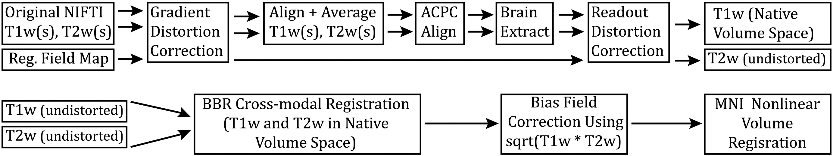
HCP PRE-FREESURFER PIPELINE

Slide 17
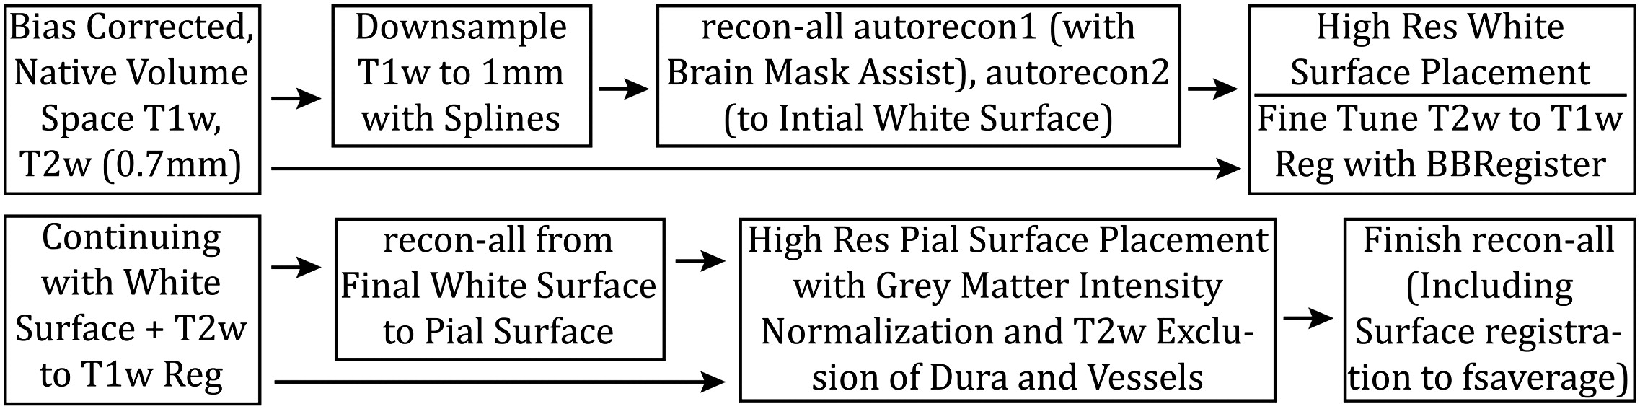
HCP FREESURFER PIPELINE

Slide 18
WEEK 2
FUNCTIONAL MRI
STRUCTURAL MRI
PROCESSING PIPELINES
Lynne J. Williams, Ph.D.
BCCH MRI Research Facility

Slide 19
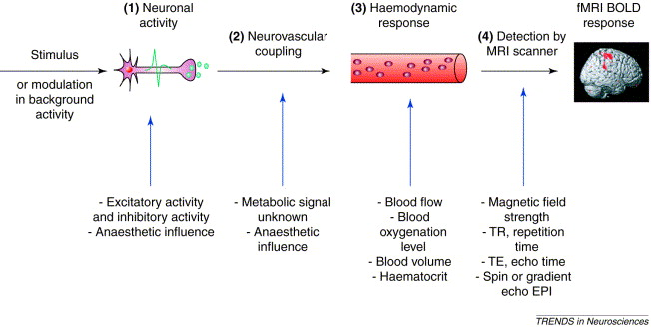

Arthurs & Boniface (2002). Trends in Neurosciences, 25
DOI: 10.1016/S0166-2236(00)01995-0
Trends in Neurosciences 2002 25, 27-31DOI: (10.1016/S0166-2236(00)01995-0)
Notes:
The BOLD signal has several constituents: (1) the neuronal response to a stimulus or background modulation; (2) the complex relationship between neuronal activity and triggering a haemodynamic response (termed neurovascular coupling); (3) the haemodynamic response itself; and (4) the way in which this response is detected by an MRI scanner.

Slide 20
Arthurs & Boniface (2002). Trends in Neurosciences, 25
DOI: 10.1016/S0166-2236(00)01995-0
Trends in Neurosciences 2002 25, 27-31DOI: (10.1016/S0166-2236(00)01995-0)
Notes:
The BOLD signal has several constituents: (1) the neuronal response to a stimulus or background modulation; (2) the complex relationship between neuronal activity and triggering a haemodynamic response (termed neurovascular coupling); (3) the haemodynamic response itself; and (4) the way in which this response is detected by an MRI scanner.

Slide 21
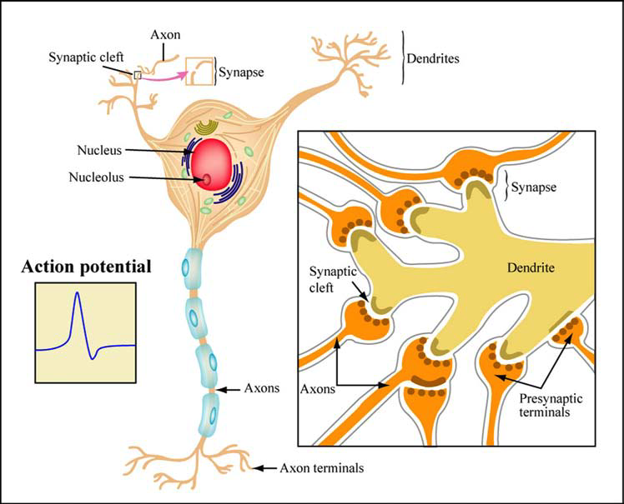
From MIT Open Courseware

Slide 22
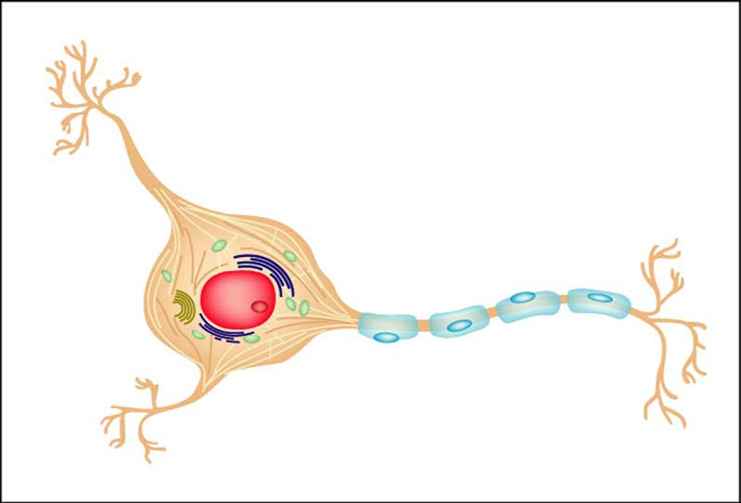
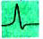
SIGNAL
CONDUCTION
Action Potential
From MIT Open Courseware

Slide 23
Action Potential
SIGNAL
CONDUCTION
From MIT Open Courseware
Action Potential initiates when Na+ channels open in axon base and allow Na+ ions to flow in
Electrochemical gradient drives Na+ inflow:
High concentration of Na+ outside of neuron, low [Na+] inside
Outside of neuron more electrically positive than inside
Flow of positively charged Na+ into cell is energetically favorable process (does not require energy)

Slide 24
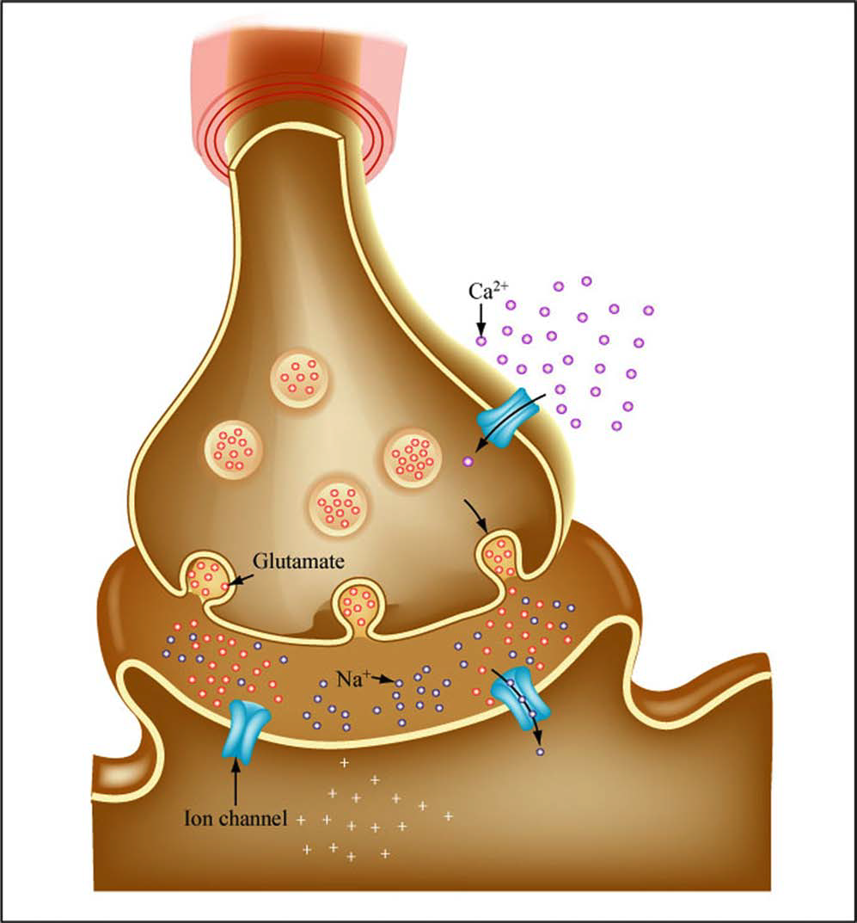
SIGNAL
CONDUCTION
AP travels down axon towards terminal
AP depolarizes presynaptic membrane
Neurotransmitter-filled vesicles populate distal end of axon
Gives either an excitatory or inhibitory effects depending upon neurotransmitter and receptor types
Excitatory effect leads to depolarization
Inhibitory effect leads to hyperpolarization
From MIT Open Courseware

Slide 25
SIGNAL CONDUCTION
APs are generated through integration of excitatory and inhibitory inputs
Signal once past threshold
From MIT Open Courseware

Slide 26
Arthurs & Boniface (2002). Trends in Neurosciences, 25
DOI: 10.1016/S0166-2236(00)01995-0
Notes:
The BOLD signal has several constituents: (1) the neuronal response to a stimulus or background modulation; (2) the complex relationship between neuronal activity and triggering a haemodynamic response (termed neurovascular coupling); (3) the haemodynamic response itself; and (4) the way in which this response is detected by an MRI scanner.

Slide 27
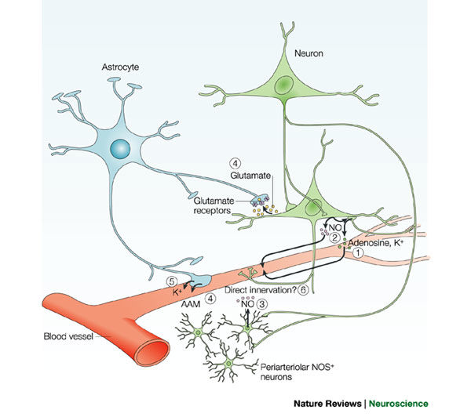
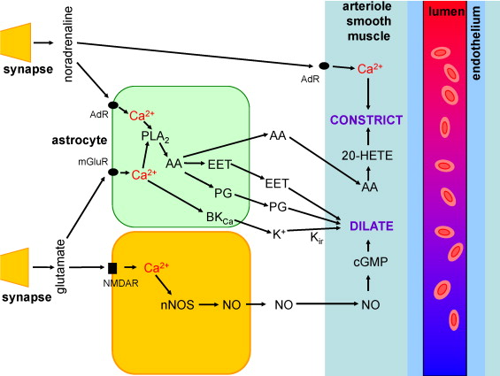
D’Esposito et al. (2003). Nature Reviews Neuroscience, 4
Harris et al. (2011). Developmental Cognitive Neuroscience, 1, 3

Slide 28
NEURONAL
ENERGY
REQUIREMENTS
Post-synaptic potentials and action potential generation depend on electrochemical gradients, ion flow, & neurotransmitter release
As signaling proceeds ion and neurotransmitter stores get depleted
For neuronal signaling to continue
Ion levels and electrochemical gradients must be reestablished
Neurotransmitters must be returned to the neuron
www.yourwebsite.com

Slide 29
NEURONAL
ENERGY
REQUIREMENTS
ENERGY SOURCE NEEDED
ATP
www.yourwebsite.com

Slide 30
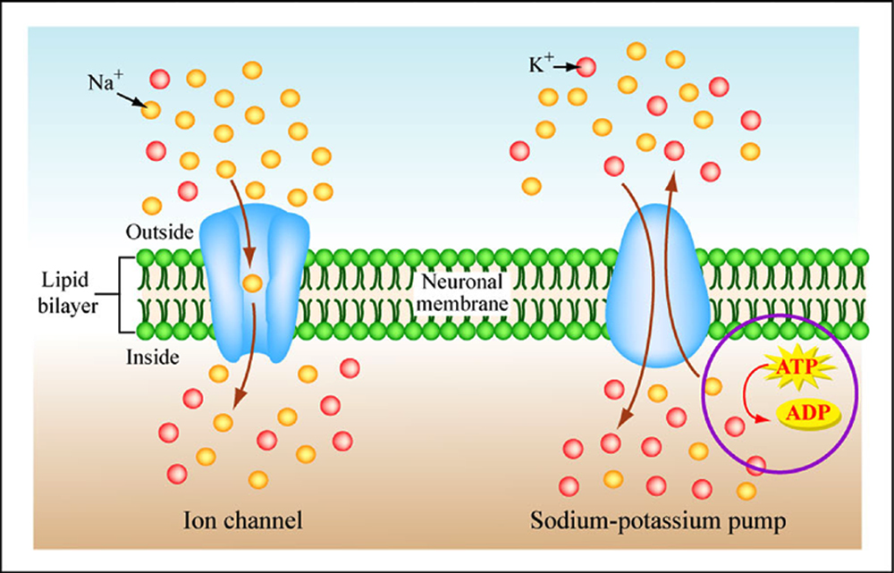
Ion pumps restore electro-chemical gradient by pumping ions into or out of neuron
Requires ATP
From MIT Open Courseware

Slide 31
Arthurs & Boniface (2002). Trends in Neurosciences, 25
DOI: 10.1016/S0166-2236(00)01995-0
Notes:
The BOLD signal has several constituents: (1) the neuronal response to a stimulus or background modulation; (2) the complex relationship between neuronal activity and triggering a haemodynamic response (termed neurovascular coupling); (3) the haemodynamic response itself; and (4) the way in which this response is detected by an MRI scanner.

Slide 32
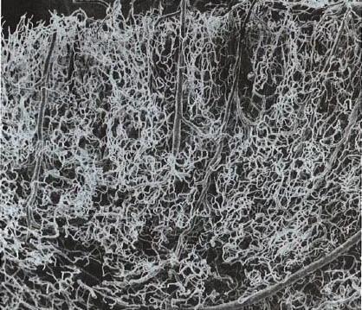
MICRO-
VASCULAR
STRUCTURE
Devernoy, et al. "Cortical blood vessels of the human . brain." Brain Research BulletinBrain Bulletin7, no. 5 (November 1981): 5197, 519--579.579.
Notes:
PerfusionPerfusiondescribes nutritive delivery of arterial describes blood to a capillary tissue bedblood bed
􀂄􀂄CBFCBFis the rate of delivery of arterial blood to is capillary beds of particular mass (or volume)
􀂄􀂄CBVCBV(cerebral blood volume) is the faction of (the tissue volume occupied by microvesselsmicrovessels
􀂄􀂄Mean transit time ττ) is the time it takes blood ) to flow through a defined volume; ττ= CBV/CBF= CBF(

Slide 33
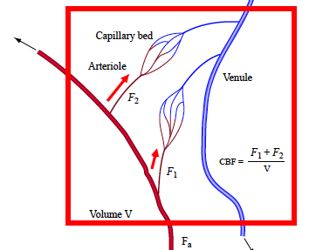
CEREBRAL
BLOOD
FLOW
Depends on
Total flow to capillaries in voxel
Volume of voxel
From MIT Open Courseware.
After Buxton, Introduction to fMRI, 2002.
Notes:
Flow = volume/time
CBF_MRI somewhat different
Flow to capillaries in imaging volume

Slide 34
CEREBRAL
BLOOD
FLOW
Blood that flows through a voxel does not count towards CBF
This blood goes to other voxels and will contribute for that) voxel (no double dipping)
From MIT Open Courseware.
After Buxton, Introduction to fMRI, 2002.
Notes:
Flow = volume/time
CBF_MRI somewhat different
Flow to capillaries in imaging volume

Slide 35
CEREBRAL
BLOOD
FLOW
Typical gray matter CBF
From MIT Open Courseware.
After Buxton, Introduction to fMRI, 2002.
Notes:
Flow = volume/time
CBF_MRI somewhat different
Flow to capillaries in imaging volume

Slide 36
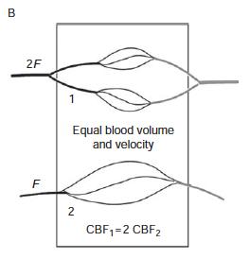
CENTRAL
VOLUME
PRINCIPLE
Intuitively, it seems that specifying the blood volume and blood velocity ought to determine CBF
but
They don’t.
Buxton (2009). Introduction to fMRI. p 36
Notes:
Measurement of blood volume and blood velocity is not suﬃcient to measure CBF
In the lower capillary bed, the vessels are twice as long as those in the upper capillary bed, so the blood volume and blood velocity are the same, yet the CBF is twice as large in the upper capillary bed. Instead of blood volume and blood velocity determining CBF, it is blood volume and transit time that determine CBF through the central volume principle.

Slide 37
CENTRAL
VOLUME
PRINCIPLE
Rather, it is capillary transit time that is more directly tied to CBF
Stewart (1894)
Buxton (2009). Introduction to fMRI. p 36
Notes:
Measurement of blood volume and blood velocity is not suﬃcient to measure CBF
In the lower capillary bed, the vessels are twice as long as those in the upper capillary bed, so the blood volume and blood velocity are the same, yet the CBF is twice as large in the upper capillary bed. Instead of blood volume and blood velocity determining CBF, it is blood volume and transit time that determine CBF through the central volume principle.

Slide 38
PHYSIOLOGICAL
CHANGES
DURING
ACTIVATION
NEURONAL
CHANGES
VASCULAR
CHANGES
METABOLIC
CHANGES
Figure design by presentationgo.com

Slide 39
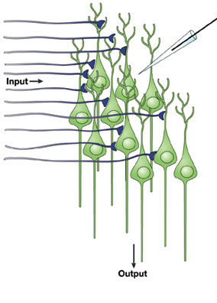
NEURONAL
CHANGES
fMRI picks up on activity of ensembles of neurons firing in synchrony
Iadecola (2004). Nature Reviews Neuroscience, 5, 347–360. doi:10.1038/nrn1387

Slide 40
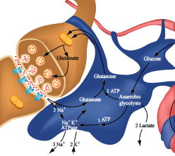
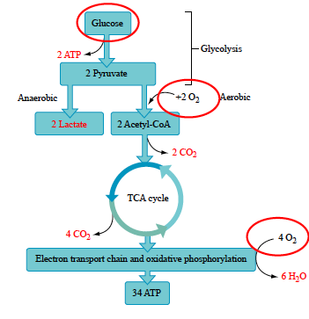
METABOLIC
CHANGES
Neural activation is associated with increases in:
Oxygen metabolism
Glucose metabolism
Images from MIT Open Courseware.
after Huttel et al., Introduction to fMRI, 2002.

Slide 41
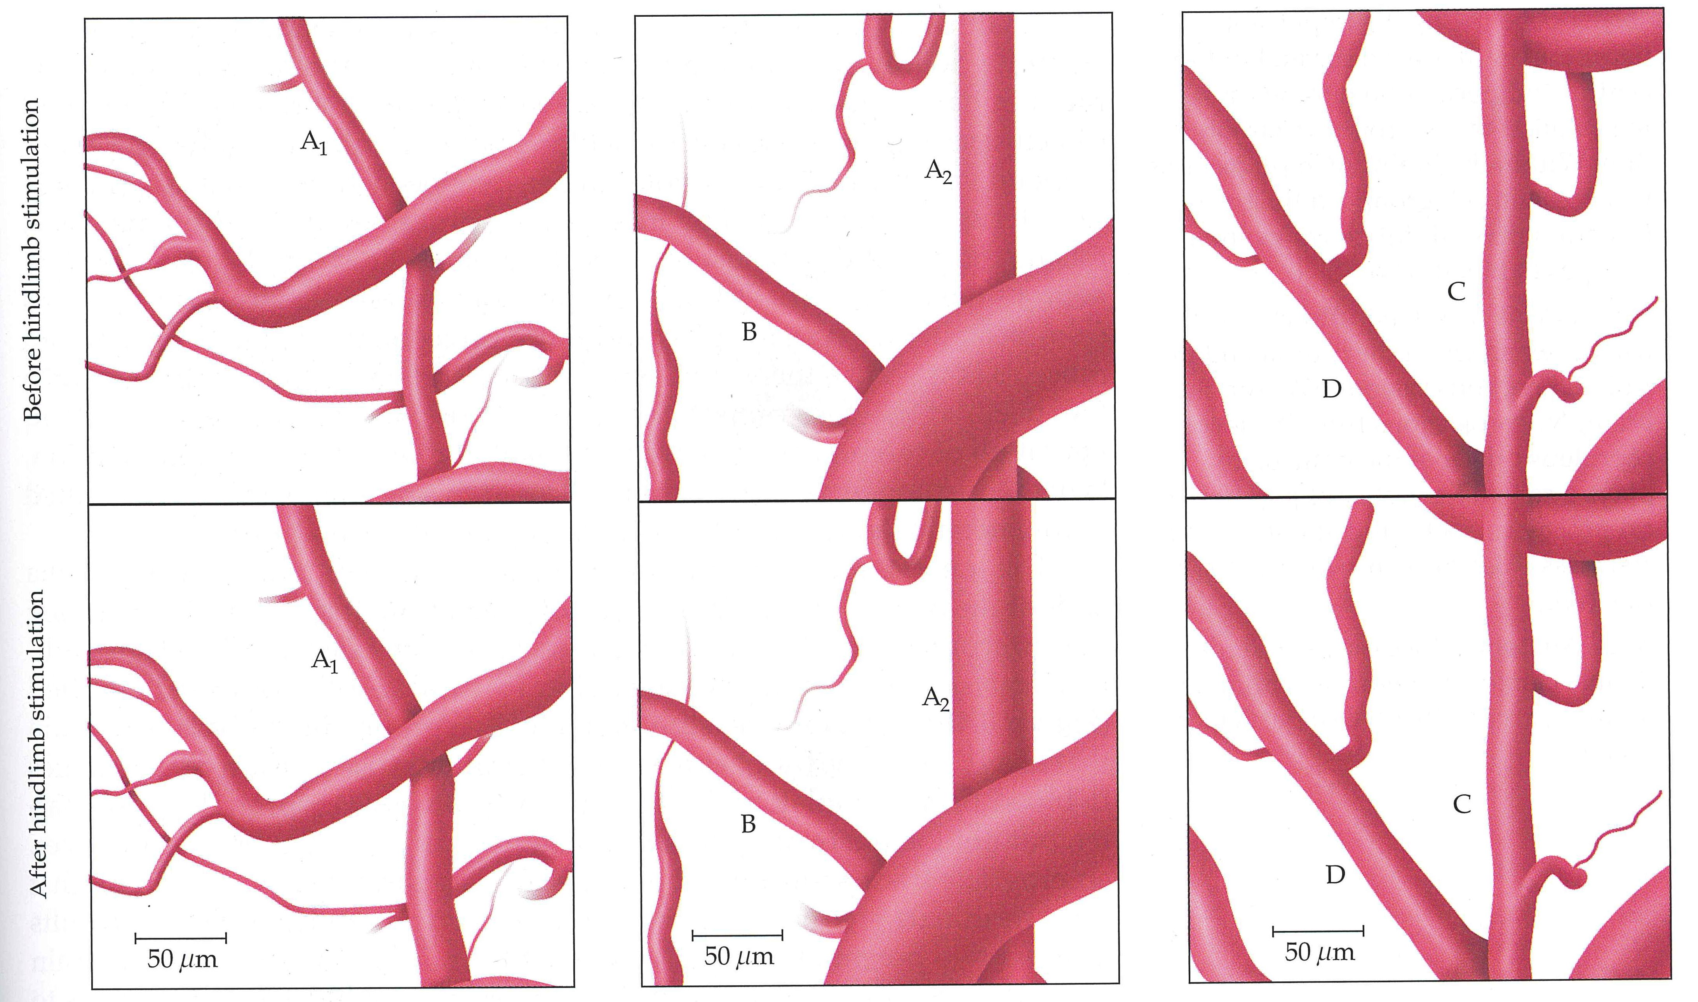
VASCULAR
CHANGES
CBF increases during activation
Δ vessel radius
Δ velocity of flow
Image from
Huttel et al. (2014). Introduction to fMRI, p. 183
(After Ngai et al., 1998)

Slide 42
VASCULAR
CHANGES
Very small changes in vessel diameter can produce large changes in resistance and flow
Image from
Huttel et al. (2014). Introduction to fMRI, p. 183
(After Ngai et al., 1998)

Slide 43
CHANGES IN BLOOD FLOW, OXYGEN DELIVERY AND OXYGEN CONSUMPTION SERVE AS MARKERS FOR NEURAL ACTIVITY

Slide 44
“Blood very likely may rush to each region of the cortex according as it is most active.”
William James (1890)

Slide 45
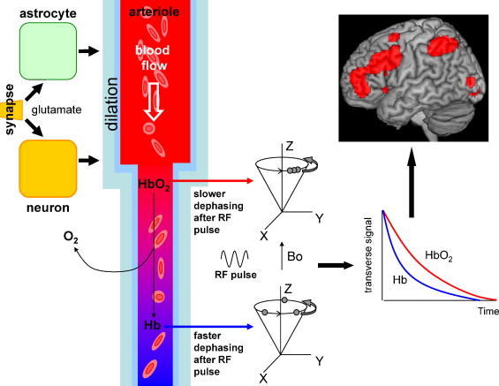
FUNCTIONAL
HYPEREMIA
Harris et al. (2011). Developmental Cognitive Neuroscience, 1, 3

Slide 46
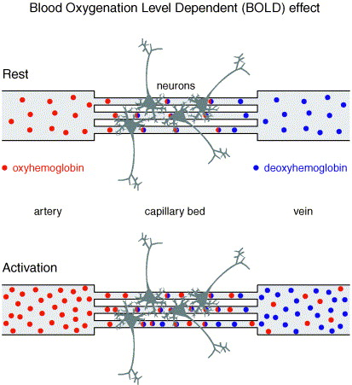
BOLD
EFFECT
Under normal conditions, oxygenated hemoglobin is converted to deoxygenated hemoglobin within the capillary bed at a constant rate
Image from: Dogil et al. (2002). Journal of Neurolinguistics, 15(1), 59-90

Slide 47
BOLD
EFFECT
When neurons become active, the vascular system supplies more oxygenated hemoglobin than is needed via an overcompensatory increase in blood flow.
Image from: Dogil et al. (2002). Journal of Neurolinguistics, 15(1), 59-90

Slide 48
BOLD
EFFECT
The result is a net decrease in deoxygenated hemoglobin and a corresponding decrease in signal loss due to T₂* effects
Image from: Dogil et al. (2002). Journal of Neurolinguistics, 15(1), 59-90

Slide 49
Arthurs & Boniface (2002). Trends in Neurosciences, 25
DOI: 10.1016/S0166-2236(00)01995-0
Notes:
The BOLD signal has several constituents: (1) the neuronal response to a stimulus or background modulation; (2) the complex relationship between neuronal activity and triggering a haemodynamic response (termed neurovascular coupling); (3) the haemodynamic response itself; and (4) the way in which this response is detected by an MRI scanner.

Slide 50
Harris et al. (2011). Developmental Cognitive Neuroscience, 1, 3

Slide 51
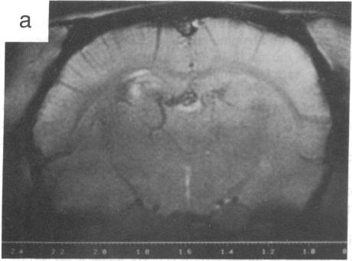
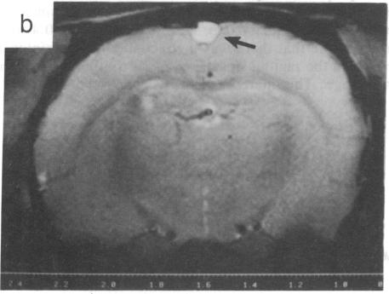
EFFECT OF CO₂
ON BOLD CONTRAST
Coronal slice brain image showing BOLD contrast from a rat anesthetized with urethane. The gas inspired was 100% O₂.
The same brain but with 90% O₂/10%CO₂ as the gas inspired. BOLD contrast is greatly reduced
Ogawa et al., PNAS, 1990, 87 (24) 9868-9872; DOI: 10.1073/pnas.87.24.9868

Slide 52
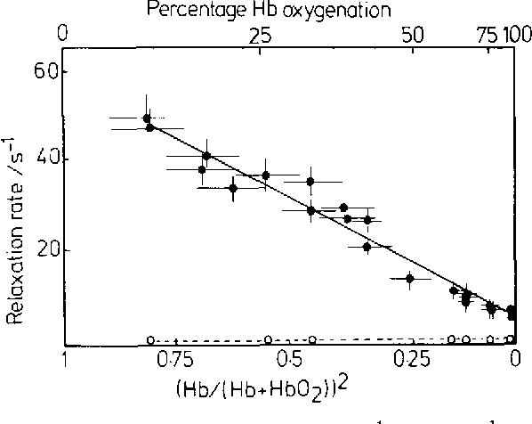
EFFECT OF BLOOD DEOXYGENATION
ON MR RELAXATION

Slide 53
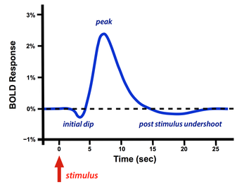
BOLD HEMODYNAMIC RESPONSE

Slide 54
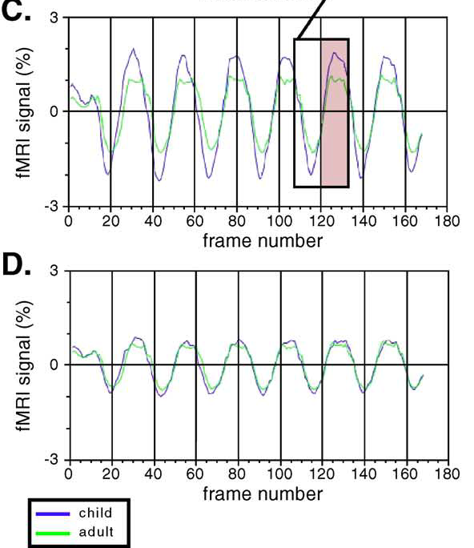
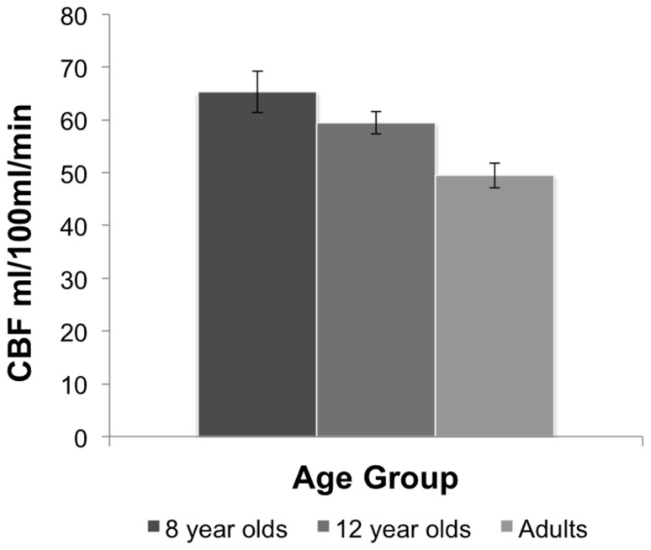
AGE-RELATED DIFFERENCES IN BOLD
Thomason et al. (2005). Neuroimage, 25
Moses et al. (2014). Frontiers in Psychology, 5

Slide 55
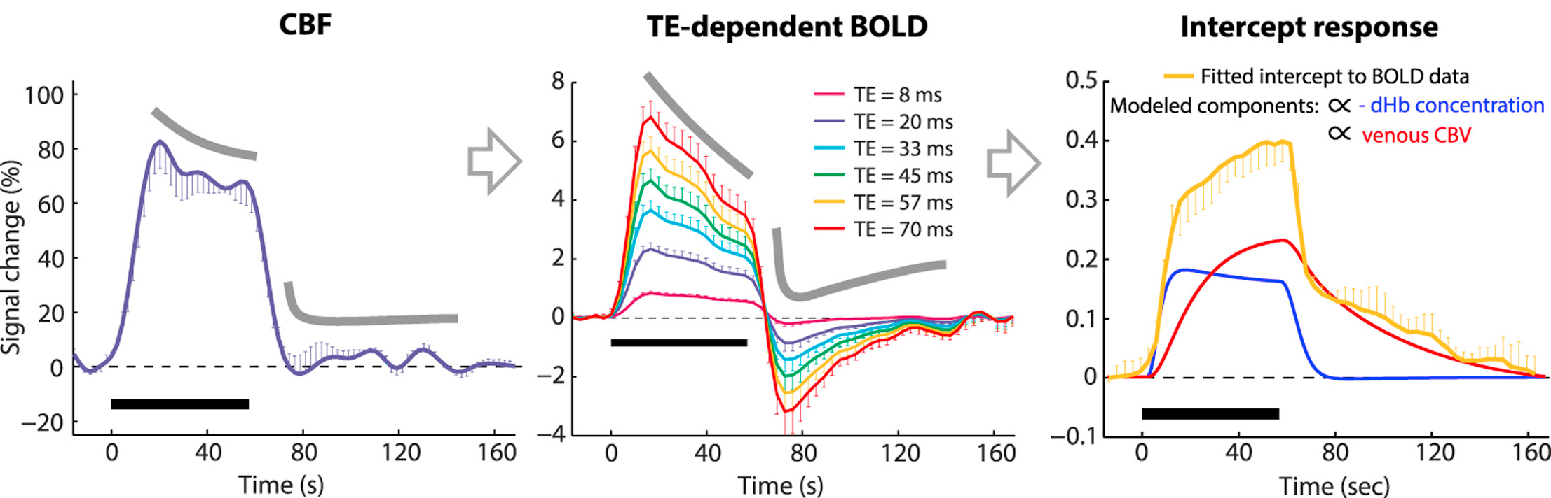
TE RELATED DIFFERENCES IN BOLD SIGNAL
Havlicek et al. (2017). Neuroimage, 159, DOI: 10.1016/j.neuroimage.2017.07.034

Slide 56
Arthurs & Boniface (2002). Trends in Neurosciences, 25
DOI: 10.1016/S0166-2236(00)01995-0
Notes:
The BOLD signal has several constituents: (1) the neuronal response to a stimulus or background modulation; (2) the complex relationship between neuronal activity and triggering a haemodynamic response (termed neurovascular coupling); (3) the haemodynamic response itself; and (4) the way in which this response is detected by an MRI scanner.

Slide 57





© 2018 BC CHILDREN’S HOSPITAL MRI RESEARCH FACILITY
This work is licensed under the Creative Commons Attribution-NONCOMMERCIAL-ShareAlike 4.0 International License. To view a copy of this license, visit http://creativecommons.org/licenses/by-nc-sa/4.0/..
THANK YOU
BCCH MRI Research Facility

